Slide 1


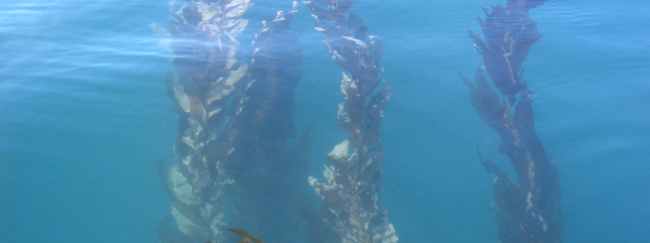
Assessing ecosystem condition using expert judgment
Dr. Liz Whiteman, Dr. Tess Freidenburg
MPA Monitoring Enterprise, California Ocean Science Trust

Slide 2
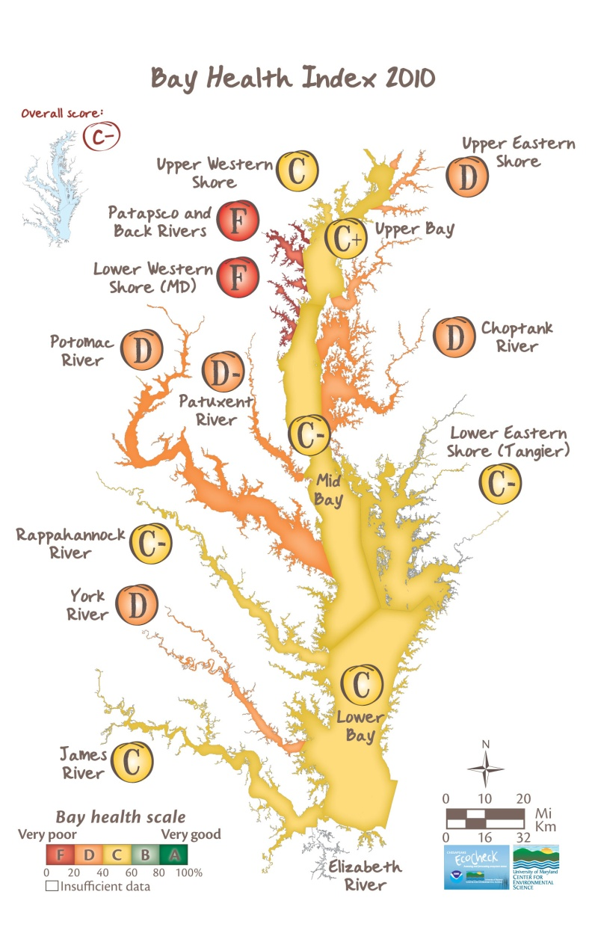
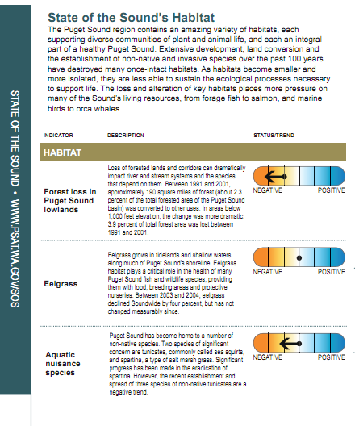
Giving ecosystems a ‘grade’
Notes:
Familiar w increasing use of report card approaches…two examples from Queensland rivers and the Puget Sound Partnership

Slide 3
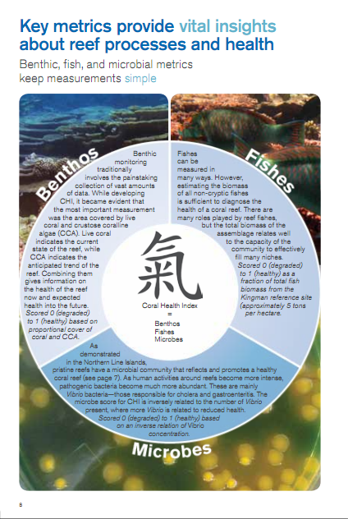
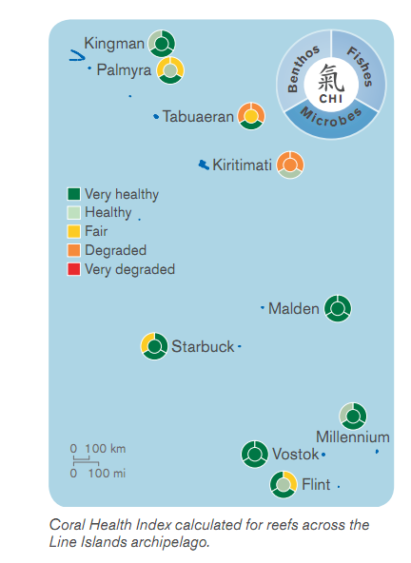
To raise awareness
Notes:
Support communications objectives to increase awareness, to educate about changing ecosystem health or condition

Slide 4
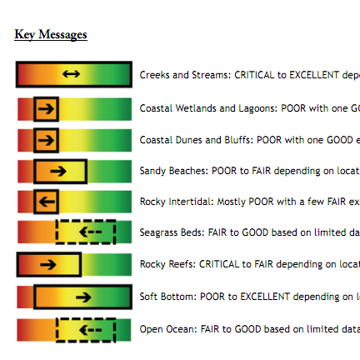
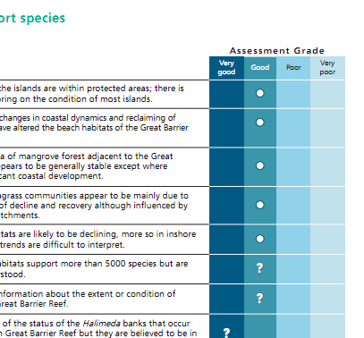
To inform management decisions
SMBRC State of the Bay 2010
GBRMPA Outlook Report 2009
Notes:
Growing use of this tool to:
Evaluate effectiveness of prior management actions;
Provide guidance on where and how to target management activities
Provide guidance on allocating resources, being strategic about conservation

Slide 5
Providing guidance on where to act
Notes:
Potentially quite a powerful ‘decision-suppport’ tool for management.
Lets take a brief example.
In CA, 119 Marine Protected Areas implemented; designed to protect the ecosystems of the Pacific Coast. Current policy recomends that these management actions, be evaluated every 5 years.
Make science-based choices about where and how to act.

Slide 6
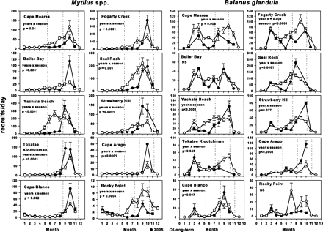
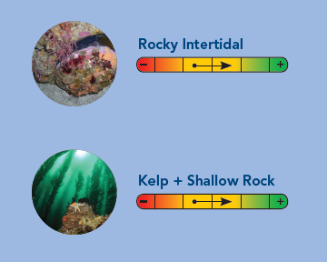
How are results produced?
Notes:
But of course it’s not a simple process to move from complex, multivariate data sets to a single condition assessment. While we can use quantittive approaches to estimate processes, or components of ecosystem health, there isn’t a simple formulaic approach to plug in numbers and arrive at an overarching ecosystem condition score.
So how should this challenge be addressed, and thinking about our prior examples, how do we develop report cards, or condition assessments that decision-makers will deem credible, that they can use as a basis for science-informed management or decision-making.

Slide 7
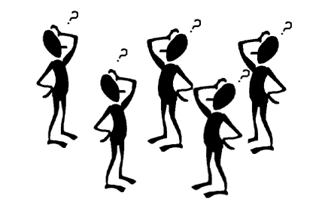
The role of expert judgment
Good?
Improving?
Bad?
Declining?

Slide 8

Thinking about good practice
Different ‘experts’
Different inputs: raw data, synthesized results
Different process steps
Different desired outcomes (e.g., consensus)
Different tools
Different dissemination strategies

Slide 9
A guiding framework
Defining scope
Selecting experts
Soliciting judgments
Sharing results
Engaging stakeholders

Slide 10
Advancing MPA monitoring
Making monitoring cost-effective and useful:
What, and how much, data are useful?
What new research is needed to illustrate how to measure ecosystem condition?

Slide 11
Thanks!
www.monitoringenterprise.org

